Slide 1
Virtual Twinning - Analyze and Predict Circuit Failure
Presented by: Ethan Barnes, Alecea Grosjean, Jimmy Roach
Advisors: Peter Jamieson and Mark Scott
Notes:
Jimmy:
Good evening
Introductions
research and construction

Slide 2








Purposes of Predicting Circuit Failure
Motivation
Notable Industries
Icons from https://uxwing.com
Notes:
Jimmy: Relate, troubleshooting, benefit, identifying, component, failure
ABG: Depending on the system, consequences of failure can range in severity. When we accurately predicting when a circuit will fail can prevent financial loss from damaged equipment or the loss of productivity due to downtimes. In the more extreme cases failing systems can lead to injury or death. As engineers we are ethically called to design fault tolerant systems that reflect a concern for human safety.
Ethan: The transportation, industrial automation, power transmission, renewable energy, and telecommunication industries are just a few that heavily utilize condition monitoring techniques, but as electrical failure isn’t something that is likely to go away, research will continue to be conducted to better identify failure.
(Industries, high damage when failure)

Slide 4
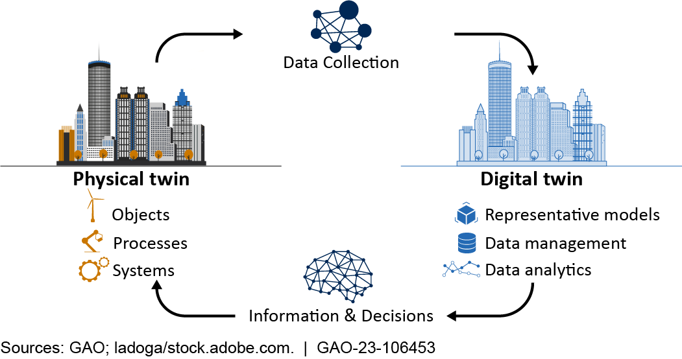
What is Virtual Twinning?
Notes:
ABG: So what is Virtual Twinning? Virtual twinning is an approach in which a physical system is simulated digitally. To predict failure we must first know how a circuit would operate in its ideal conditions or have a baseline to compare the results of a failing circuit to. This is the purpose of a virtual twin. The distinct benefit of this approach over others is that there is a less hardware utilized such as sensors which have their own rates of failure.
Jimmy:
Goal:
Inexpensive
Compare signals
Identify capacitor failure

Slide 5
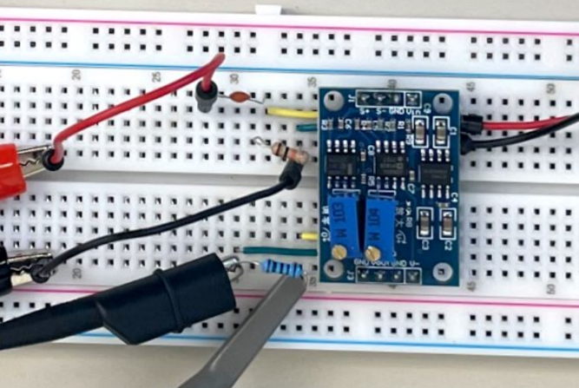
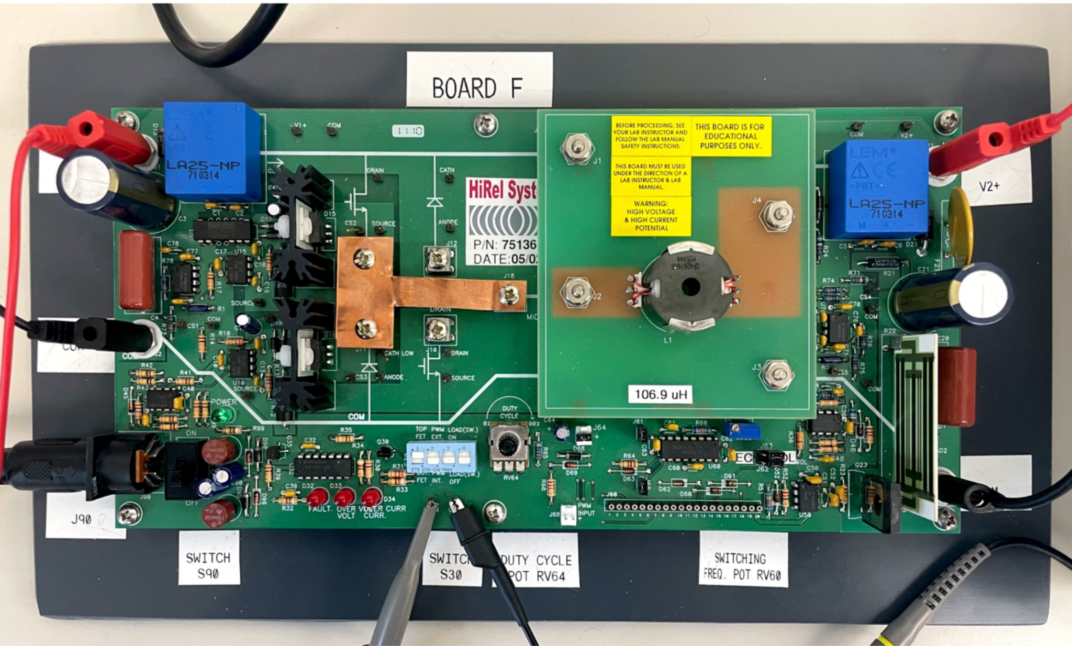
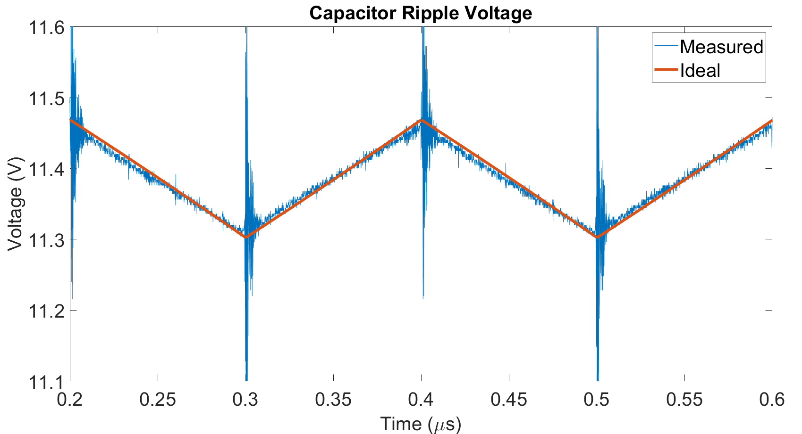
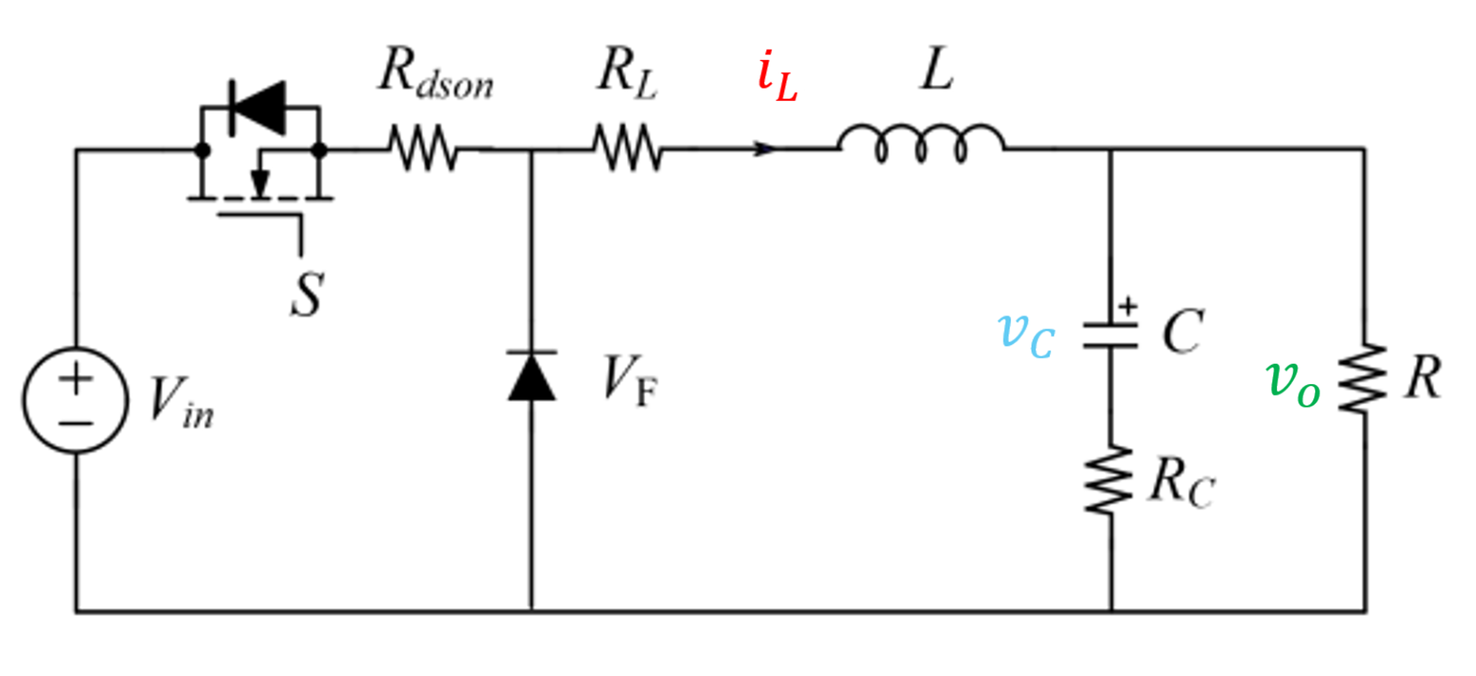
Big Picture Overview
Notes:
Ethan: Slide will be revisited, physical circuit that needs to be analyzed, simulation to compare physical to ideal, sampling of real circuit

Slide 6
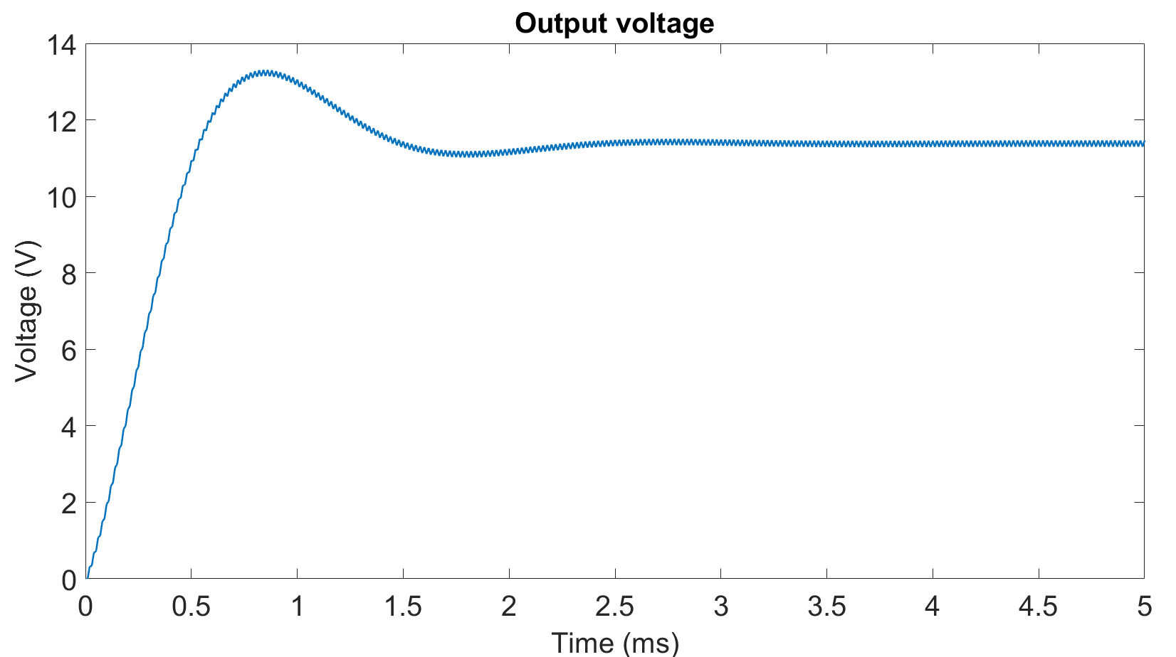
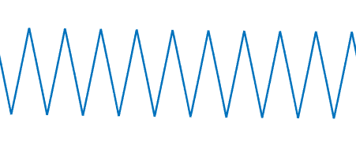
What is a Buck Converter?
Capacitor Ripple Voltage
Notes:
24 - 12
Output/Ripple
Why:
Simple
Capacitors common point failure
other components
scalability

Slide 7
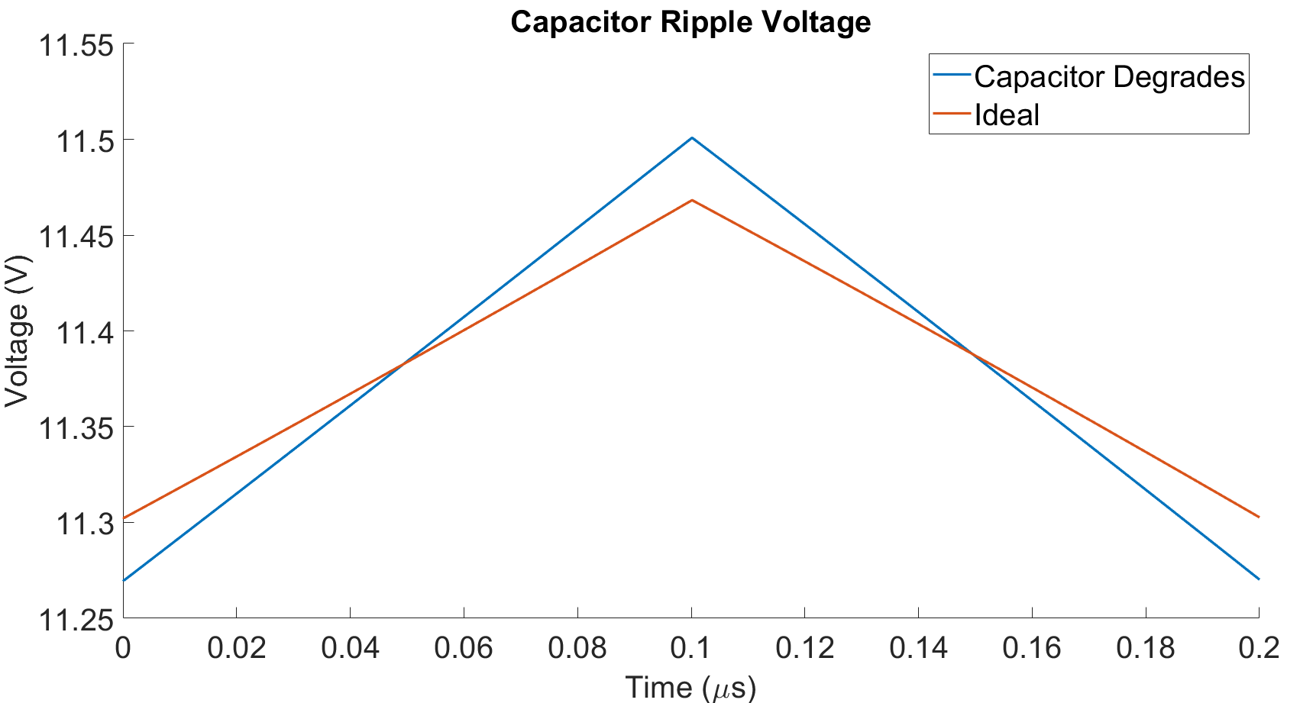
Capacitor Failure
Notes:
Indicators:
Higher Internal Resistance
Lower Capacitance

Slide 8
Big Picture Overview
Notes:
ABG: Knowing that the capacitor ripple is the indicator of circuit failure we want to analyze, we can now discuss our process to create the virtual twin of the waveform from the given circuit topology.

Slide 9
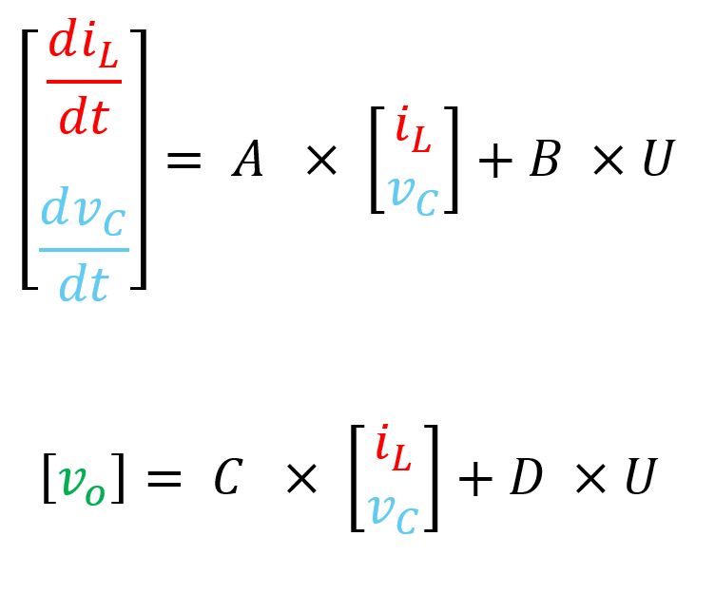
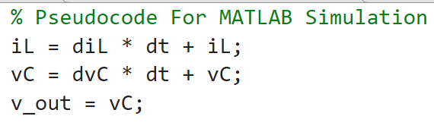
Simulation
Notes:
ABG: While we researched multiple ways to simulate a buck converter circuit, we ultimately settled on a state space approach of modeling the circuit.
In this way, our simulation used current values of state variables to calculate the change in those values a the next time step. The state space variables of importance in our circuit were the current across the inductor labeled in red and the voltage across the capacitor labeled in blue. This approach allowed us to construct a waveform of the output voltage across the load resistor R in green above. This is more importantly the capacitor ripple voltage which was the goal of the simulation phase.
This approach was selected since it enabled us to specialize the results to our circuit gaining accuracy while still being scalable for other power converters.

Slide 10
Simulation Results
Notes:
ABG: To analyze the accuracy of our simulation we set up our physical circuit to collect data using a high end oscilloscope and exported the results to a csv. After this we ran our simulation with the ideal values of the components in our circuit and graphed the results on one another. It is from these results that we believe that our simulation models the performance of the buck converter with enough accuracy. As the shape and peak values of the measured data changes we believe it will differ enough from our simulation to label the capacitor as failing.
The distinct benefit of utilizing this method of simulation is in the accuracy we can gain by specializing the results to this circuit. The process can still be utilized by other LTI circuits but there are benefits to this method for complex circuits (Talk about how its more accurate than LTSPice)
The graph resulting in the comparison between our simulated ripple voltage data and measured data from our circuit can be seen above. We believe that this simulation method models the data well enough to predict failure when compared with real time data changes. Since the ripple voltage has a peak to peak voltage of 150mv with a DC offset of 11.38V, this signal can be more easily processed.
This process laid our virtual twin's groundwork, enhancing our understanding of the buck converter and improving our readiness for ADC testing.

Slide 11
Big Picture Overview
Notes:
Ethan: Why sampling? DC offset/Low voltage diff

Slide 12
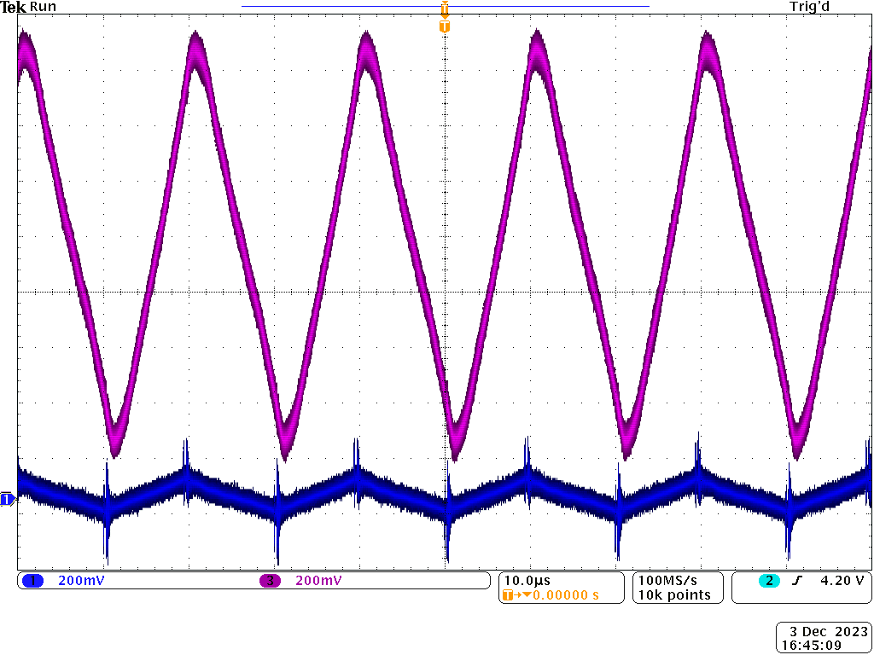
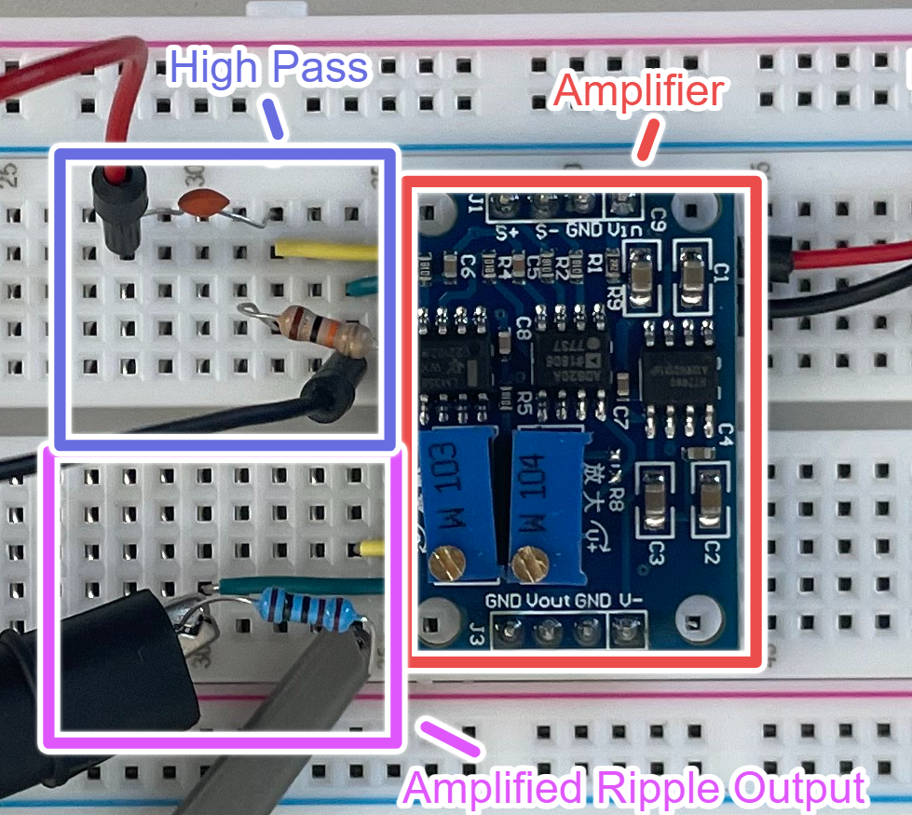
Signal Processing
Notes:
Ethan: A high pass filter eliminates the DC offset, and an amplifier is used to give the output a range from 0 to 2V. This amplified output is much easier to measure.

Slide 13
Transition to J-Term and Spring
J-Term Goals:
- Solidify understanding of ADC and Embedded System Solutions
Spring Semester Goals:
- Construct ADC and Embedded System Solutions
- Implement algorithm to predict capacitor failure
Notes:
Jimmy:
J-term goals
End goals:
Ethan: Our immediate agenda at the start of next semester will involve testing the ADC solutions identified over J-Term. Furthermore, we plan to begin developing an algorithm to detect diff in capacitor ripple waveform.

Slide 14
Big Picture Overview
Notes:
Thank Advisors
Support
Guidance
Looking forward to…
Thank you for your attention. We will now take any questions.

